Slide 1
RPID: CTS URN + Handle
Bridget Almas
June 21, 2018
Pelagios Linked Texts Working Group
This project was funded by the National Science Foundation under award #1659310.

Slide 2
Problem Statement
No standard approach for turning a CTS URN into a resolvable URL
domain name and rewrite rules
redirect requests
custom resolution services
Consumers of CTS URNs cannot discover the URL for the CTS API that serves any given URN

Slide 3
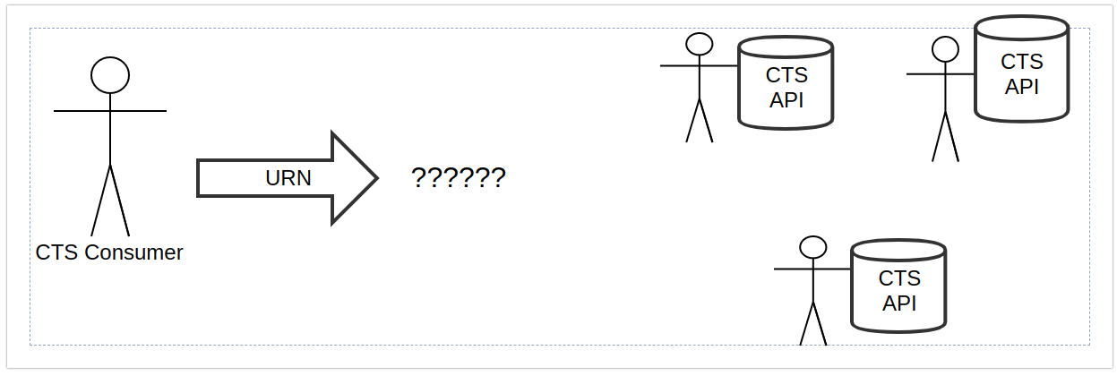
Problem Statement

Slide 4
Requirements
Standard approach
Distributed publishing
Centralized management of resolution
Reliable infrastructure
Governance structures

Slide 5
Handle System Characteristics
Widely used - worldwide standard
Persistence
Supports: Multiple Instances, Multiple Attributes of Resources
International Unicode Support
Distributed Service Model
Distributed Administration Services
Efficient Resolution
Established Governance Practices

Slide 6
Proposal
Combine CTS URNs with Handles
Retention of CTS URN precision
Handle System’s flexible resolution capabilities and well-established technical and governance infrastructure
Leverage Handle System's Template feature to traverse the CTS URN structure and offer the service which matches the specificity of the URN requested.

Slide 7
Roles
Centralized Handle System Provider (CHSP) - one or more organizations assuming responsibility for registering and administering Handle prefixes for CTS Namespaces
Participating CTS Text Publisher (PCTP) - a publisher of CTS URN identified texts who wants their text URNs to be globally resolved by the Handle System
hdl.handle.net provider (HDL) - the provider of the global hdl.handle.net proxy service
Non-Participating CTS Text Publisher (NPCTP) - a publisher of CTS URN identified texts who does not want to participate in the centralized solution but wants to publish a Handle for their text

Slide 8
Responsibilities: CHSP
Registers Handle Prefixes at the level of the CTS Namespace
Creates template handles for every CTS work and CTS version within a prefix that is registered with it by PCTPs
Informs HDL of all Handle prefix -> CTS Namespace mappings under its authority
either gives the PCTPs direct edit permissions on the relevant template handle(s) or serves as general purpose handle admin and develops an out of band mechanism for the PCTPs to keep it informed of changes.
Provides a landing page for cases where a single URN resolves to multiple possible providers or service endpoints

Slide 9
Responsibilities: HDL
Maps CTS URNs to Handle Proxy urls.
Resolves potential handles in order to probe for the lowest level of granularity
First looks to see if there is an individual handle for the specific CTS edition URN, and if so it uses that
Otherwise it maps it to the prefix registered for the namespace and lets the Handle Service responsible for that prefix take over.
Supporting edition-specific handles from non-participating CTS Text Publishers requires support for a conventional handle syntax.

Slide 10
Responsibilities: PCTP
Provides a CTS Endpoint
Informs the CHSP responsible for their namespace prefix of
the list of CTS URNs for which they are going to provide services and the details of calling those services
changes to their URN mappings changes, e.g.
location of the API endpoint providing access to the edition
redirection of an previously published text to a different edition.

Slide 11
Responsibilities: NPCTP
Free to registered their own Handles for specific CTS editions without participating in the central organizational management.
In order to take advantage of the proxy system, these Handles must adhere to a standard syntax.

Slide 12
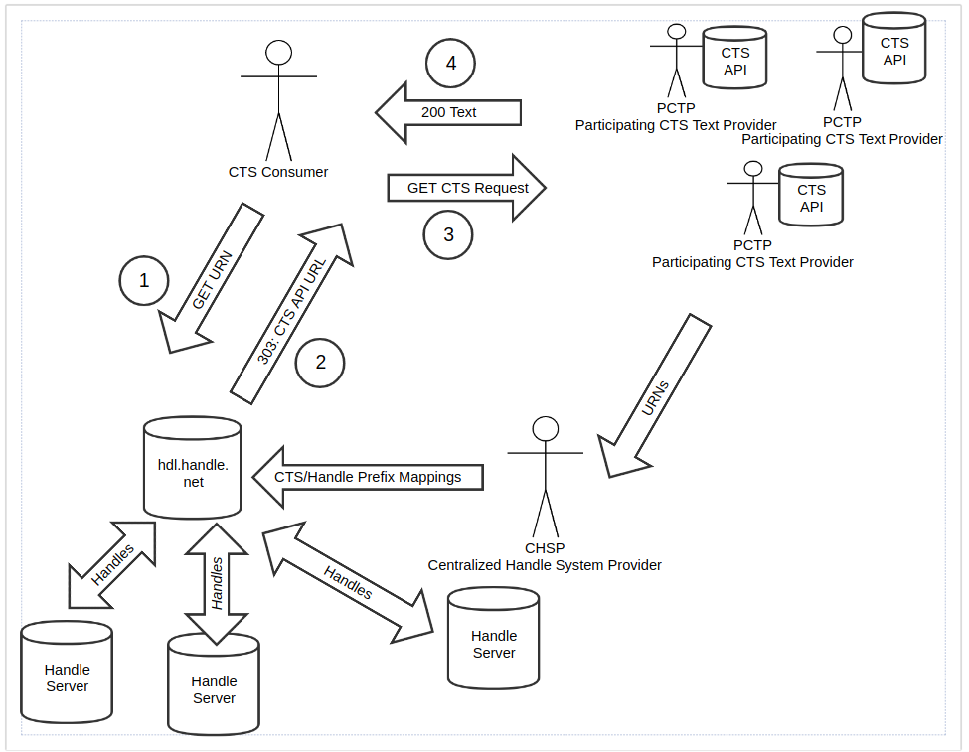

Slide 13
RPID Test Bed: Example Handles
(1) https://hdl.handle.net/20.500.12042/ctstest|urn:cts:greekLit:tlg0012.tlg002.perseus-grc2
(2) https://hdl.handle.net/20.500.12042/ctstest|urn:cts:greekLit:tlg0012.tlg002.perseus-grc2:1.1
(3) https://hdl.handle.net/20.500.12042/ctstest|urn:cts:copticLit:ap.120.monbeg
With full implementation of solution using the HDL proxy, the urls would just be:
(1) https://hdl.handle.net/urn:cts:greekLit:tlg0012.tlg002.perseus-grc2
(2) https://hdl.handle.net/urn:cts:greekLit:tlg0012.tlg002.perseus-grc2:1.1
(3) https://hdl.handle.net/urn:cts:copticLit:ap.120.monbeg

Slide 14
Links and References
This proposal was funded by the National Science Foundation under award #1659310. Co-authors Larry Lannom and Robert Tupolo-Schneck, both of CNRI. P.I. Robert Quick, Indiana University.
For full details of the proposed solution, including user stories, etc. see
https://github.com/rpidproject/cts-handles/blob/master/proposal.md
For more on RPID see https://rpidproject.github.io/rpid/#rpid-project

